Slide 1
Communication protocol RS485
Tiefighters

Slide 2
Settings on the Pi side
912600 baudrate with 1 start bit, 8 data bits, 1 stop bit.
The Raspberry Pi will send its function along with the target sensor to the RS485 bus and calculate the duration of the signal it requests to the sensor.
Based on the calculated duration the Pi will set a timeout and start reading the bus.
We need some form of flow control to give the Pi time to read and flush the buffer. We should also test if the Pi can read the buffer fast enough to handle the incoming datarate
Open question: how do we check for parity?
Open question: how do we control the flow for the Pi to flush the buffer?

Slide 3
Acoustic features
Time-domain
Frequency-domain
Time-of flight
Rise time
Settling time
Peak amplitude
Time domain energy
…
Peak power and peak frequency
Harmonic ratio
Partial power (between frequencies)
Spectral centroid
Spectral kurtosis
…

Slide 4
Metadata
Sensor number
Pi number
Function type
Function parameters
Timestamp

Slide 5
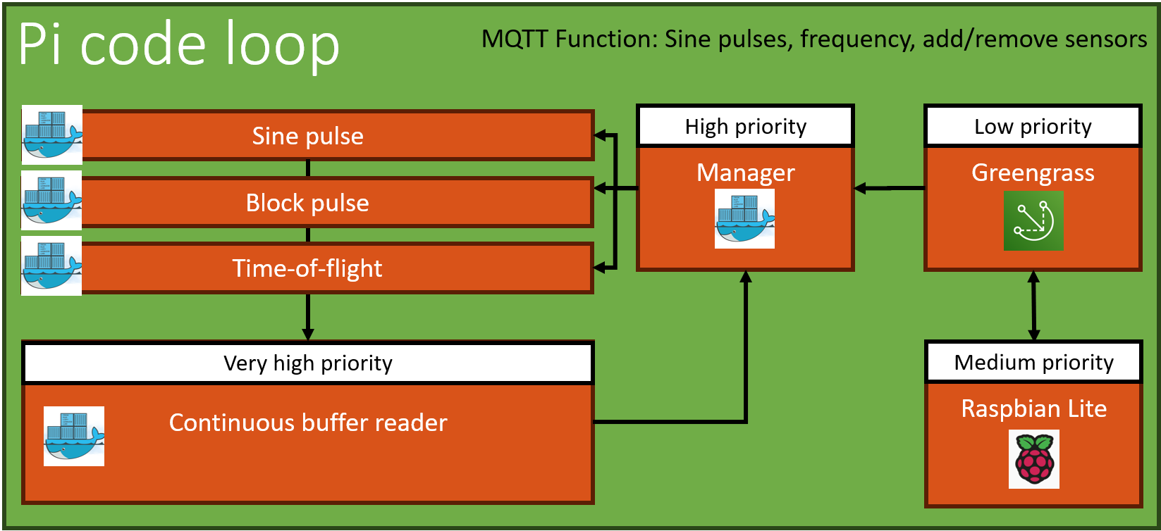









IoT Core IoT Rule
MQTT
Eventbridge
Block Feature extraction
S3 Int Storage Red.
Kinesis firehose
Sine Feature extraction
Timestream DB
Lambda - Reduction
S3 Int Storage full
Time-of-flight

Slide 6
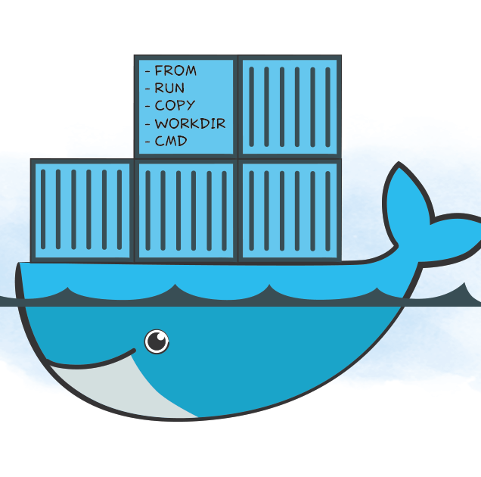
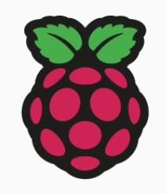
Pi code loop
MQTT Function: Sine pulses, frequency, add/remove sensors
High priority
Low priority
Eventbridge
Sine pulse
Manager
Greengrass
Block pulse
Time-of-flight
Continuous buffer reader
Medium priority
Very high priority
Raspbian Lite
IoT Core
Key considerations
Real-time requirements || Buffer sizes and flow control || Testing and monitoring

Slide 7
OLD

Slide 8
Pi code structure – Block
Very high priority
Time-of-flight
High priority
High priority
Very high priority
1 GB, 0.25 Clock
1 GB, 0.25 Clock
Low priority
Preprocessor
FFT &
Reduction
Manager
Continuous buffer reader
Feature extraction
Feature extraction
Medium priority
OS (Pi Lite)
Key considerations
Real-time requirements || Buffer sizes and flow control || Testing and monitoring

Slide 9
Pi code structure – Sine
Very high priority
Time-of-flight
High priority
High priority
Very high priority
1 GB, 0.25 Clock
1 GB, 0.25 Clock
Low priority
Preprocessor
FFT &
Reduction
Manager
Continuous buffer reader
Feature extraction
Feature extraction
Medium priority
OS (Pi Lite)
Key considerations
Real-time requirements || Buffer sizes and flow control || Testing and monitoring

Slide 10
Pi code structure – TOF
Very high priority
Time-of-flight
High priority
High priority
Very high priority
1 GB, 0.25 Clock
1 GB, 0.25 Clock
Low priority
Preprocessor
FFT &
Reduction
Manager
Continuous buffer reader
Feature extraction
Feature extraction
Medium priority
OS (Pi Lite)
Key considerations
Real-time requirements || Buffer sizes and flow control || Testing and monitoring

Slide 11
Pi code structure
Very high priority
Time-of-flight
High priority
High priority
Very high priority
1 GB, 0.25 Clock
1 GB, 0.25 Clock
Low priority
Preprocessor
FFT &
Reduction
Manager
Continuous buffer reader
Feature extraction
Feature extraction
Medium priority
OS (Pi Lite)
Key considerations
Real-time requirements || Buffer sizes and flow control || Testing and monitoring

Slide 12
IoT Core IoT Rule
Sine pulse reduction
Manager
MQTT
Block pulse reduction
Time-of-flight
Manager
Block Feature extraction
Kinesis data firehose
Sine Feature extraction
Timestream DB
S3 Storage

Slide 13

IoT Core IoT Rule
Sine pulse reduction
Greengrass+ Lambda
MQTT
Block pulse reduction
Time-of-flight
S3 Storage
AWS Lambda - Manager
Kinesis data stream
Time-of-flight
Block Feature extraction
Timestream DB
Sine Feature extraction

Slide 14
Learning step 1
IoT Core IoT Rule
Greengrass+ Lambda
MQTT
Light sensor data
S3 Storage
AWS Lambda - Manager
Kinesis data stream
Time-of-flight
Block Feature extraction
Timestream DB
Sine Feature extraction

Slide 15

Fog
Router
IoT Core IoT Rule
Greengrass+ Lambda
Light sensor data
MQTT
Kinesis firehose
AWS Lambda
Block Feature extraction
Timestream DB
S3 Storage
Sine Feature extraction
Trigger

